Slide 1
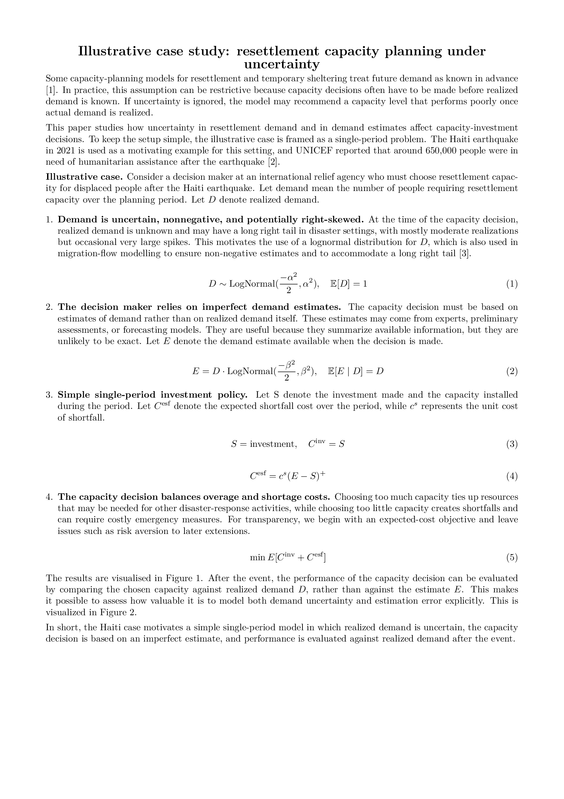
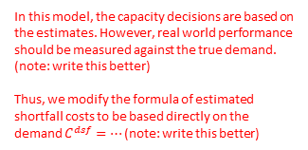

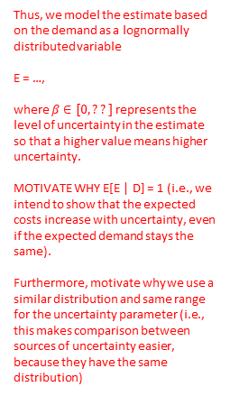










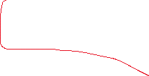
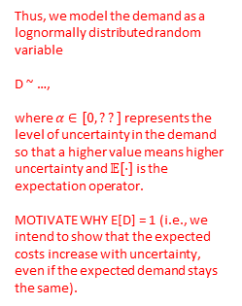
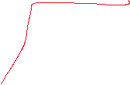
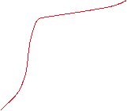




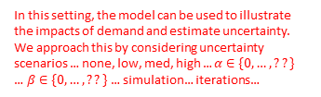









Prefer “true demand”, because the estimates cannot depend on realized demand (as the demand has not realized yet)?
Is assumed to be
Precisely? (i.e., emphasize the stochasticity)
More references (at least 5)?
Often a sentence like this is ended with (see, e.g., [1][2][3]…)
Use the same terminology
Thus, ignoring uncertainty may lead to capacity decisions that perform poorly in reality.
As an illustrative case study, we consider a single-period capacity decision problem for the Haiti….
For which …
Note verify that “humanitarian assistance” is the same as “resettlement capacity”. If so, then consider using the same terminology.
This is largely repetition of the previous paragraph. Merge? (Maybe you can add the stuff about the decision maker stuff in here)
Is power of two needed for anything? If not, then consider removing?
NOTE: Define the variables with formulas AND TEXT.
Thus, we model the demand as a lognormally distributed random variable
D ~ …,
where $α∈[0, ??]$ represents the level of uncertainty in the demand so that a higher value means higher uncertainty and $𝔼[⋅]$ is the expectation operator.
MOTIVATE WHY E[D] = 1 (i.e., we intend to show that the expected costs increase with uncertainty, even if the expected demand stays the same).
The estimates are useful because they correlate with the true demand,…
Give concrete examples for why the demand can be zero (e.g., sparsely populated location), moderate (e.g., dense population), high (e.g., dense population, long duration, cascading effects…)
estimated
Use the same terminology. Earlier “capacity decision”?
$$S∈[0, ∞]$$
Thus, we model the estimate based on the demand as a lognormally distributed variable
E = …,
where $β∈[0, ??]$ represents the level of uncertainty in the estimate so that a higher value means higher uncertainty.
MOTIVATE WHY E[E | D] = 1 (i.e., we intend to show that the expected costs increase with uncertainty, even if the expected demand stays the same).
Furthermore, motivate why we use a similar distribution and same range for the uncertainty parameter (i.e., this makes comparison between sources of uncertainty easier, because they have the same distribution)
Use the same terminology. “investment costs and shortfall costs”?
Investing in
Define the ${\left(⋅\right)}^{+}$ operator. Also textually highlight its asymmetric meaning (i.e., only too little capacity incurs costs).
$$𝔼$$
We do not consider this in the model (i.e., do not deal with it in the modeling section). You can put this in the motivation above.
We model the decision maker’s preferences through the minimization of expected costs
Motivate textually that the DM bases his decision on the estimate.
In this setting, the model can be used to illustrate the impacts of demand and estimate uncertainty. We approach this by considering uncertainty scenarios … none, low, med, high … $α∈\{0,…, ??\}$ … $β∈\{0,…, ??\}$ … simulation… iterations…
In this model, the capacity decisions are based on the estimates. However, real world performance should be measured against the true demand. (note: write this better)
Thus, we modify the formula of estimated shortfall costs to be based directly on the demand $C^{dsf}=…$ (note: write this better)
It is good to keep this in mind, but in the modeling section one typically considers only stuff that actually affects the model. Extra stuff can be added in the discussion section.
The results show that increasing uncertainty increases costs, even when the expected demand remains unchanged. This is because the shortfall costs are only incurred when the demand is not entirely met (i.e., the shortfall cost is asymmetric and is affected by the tail of the demand distribution). Thus, it could be warranted to account for these sources of uncertainty in real life resettlement capacity planning models. (write better)

Slide 2
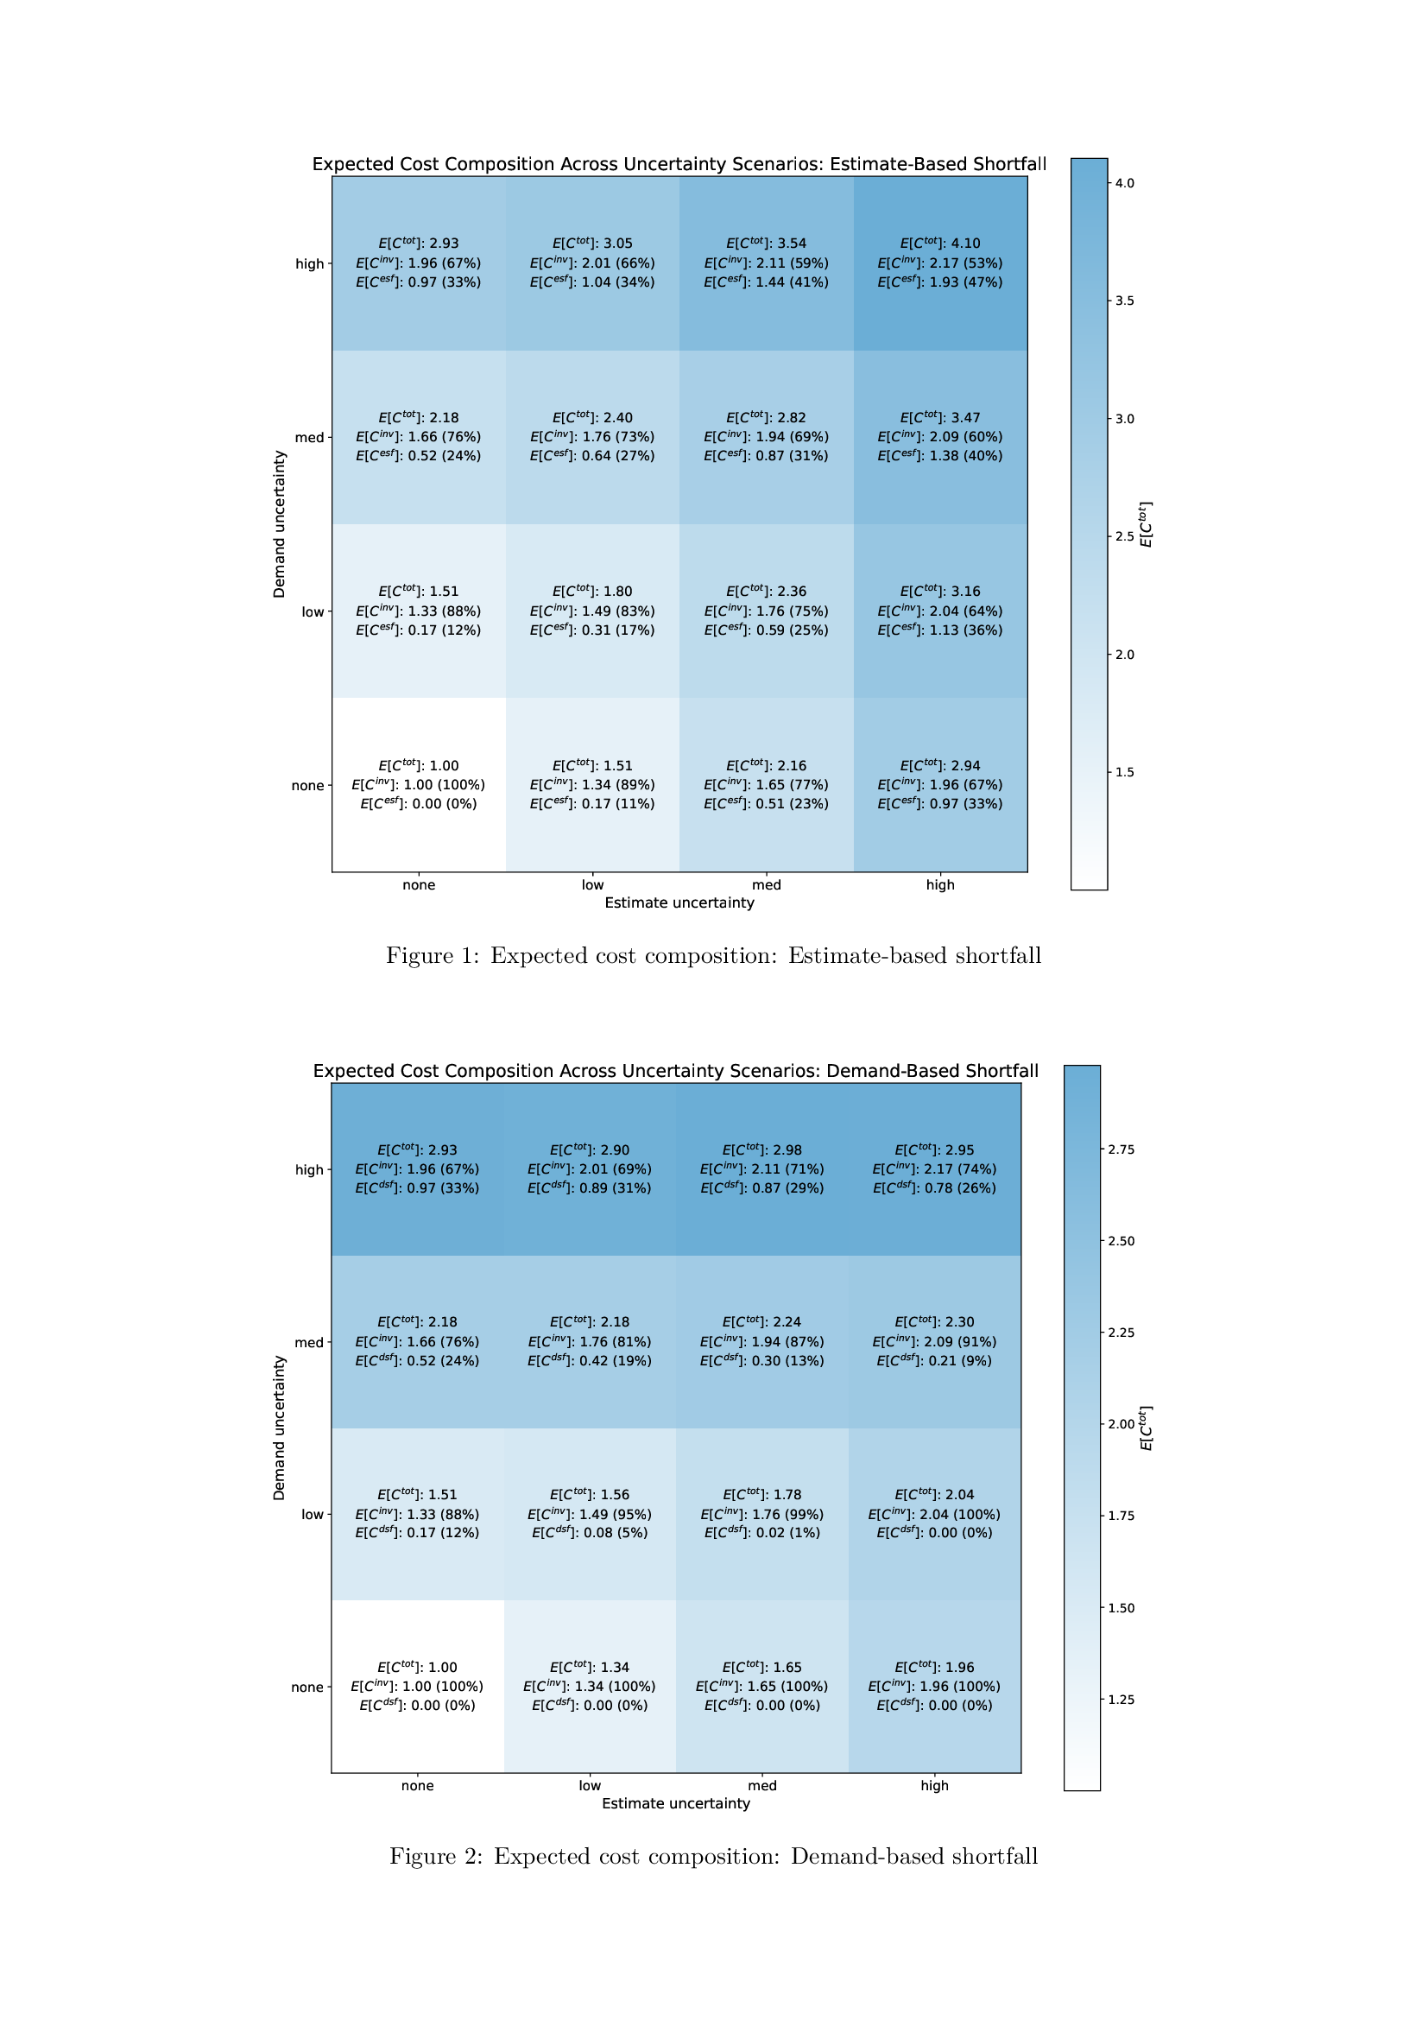
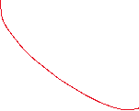
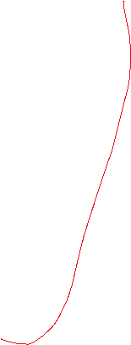
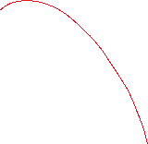
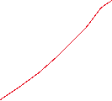
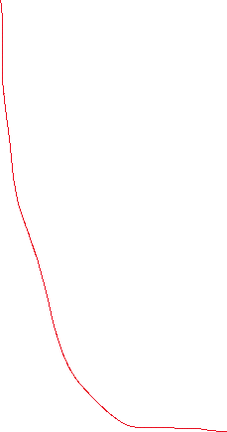





Insert the numerical values of the parameters as parentheses? I.e., “high ($α= ???)$”
Caption is sufficient.
Note that (in most journals) captions are full and proper sentences (e.g., they end in a dot).
Why are these values not increasing when the uncertainty increases? Is this just an artifact of low samples? If so, then consider rerunning so that the results are logical. If not, then what is the reason?

Slide 3
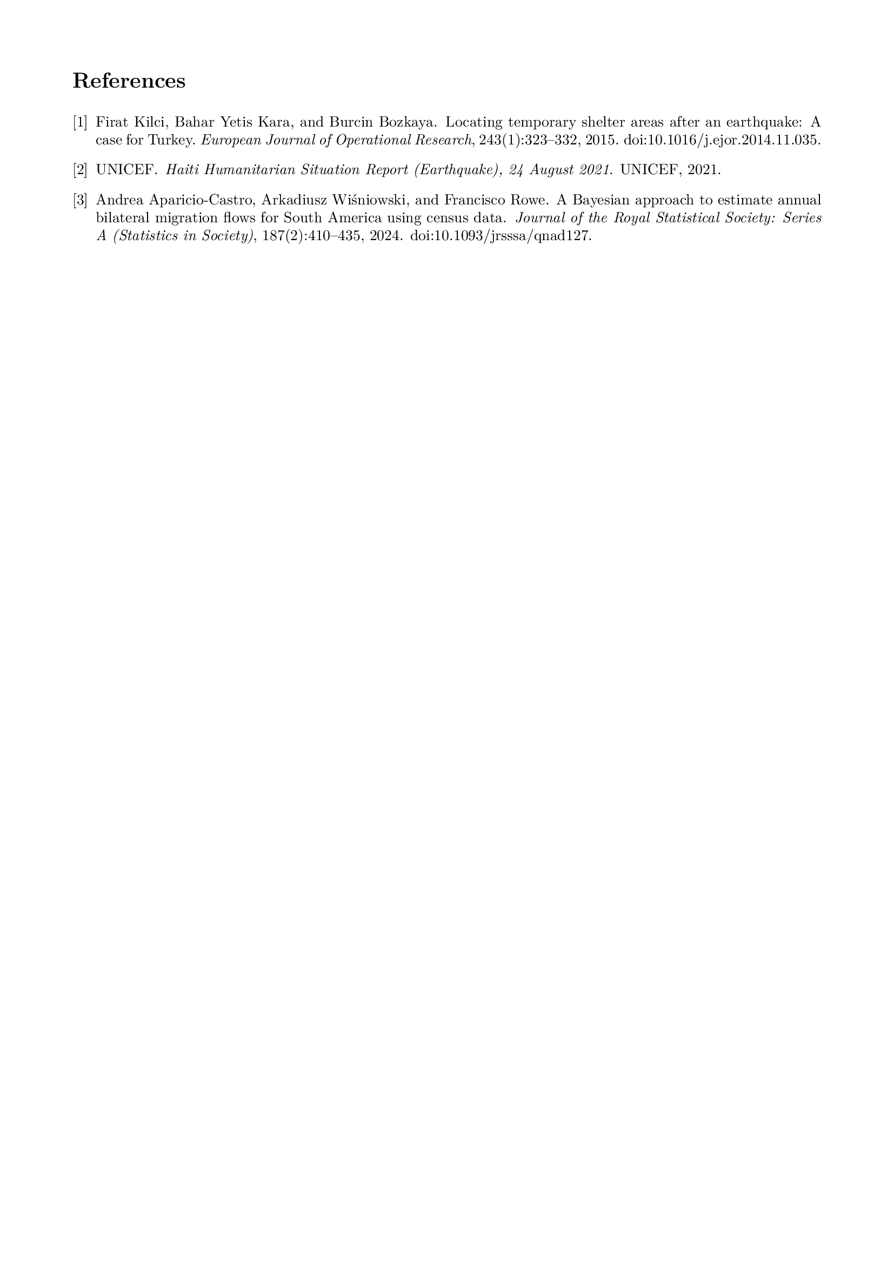
Make everything fit on one printed A4. I.e., max two pages. The description / motivation / formulas on one page so that jumping back and forth is as easy as possible.
You can achieve this by reducing the font size of the references, reducing the figure sizes slightly or reducing the font size of the text proper slightly.

